Slide 1

Diamond Price Prediction and Classification using Machine Learning Algorithms

Slide 2
Abstract
Diamonds are one of the most precious and valuable commodities, and their prices are influenced by several factors, including carat, cut, clarity, and color. With the help of machine learning algorithms, it is possible to predict diamond prices more accurately. In this study, classification algorithms, like XGBoost, AdaBoost, Random Forest, Gradient Boosting, Logistic Regression, Decision Tree, Naïve Bayes were utilized to classify diamond prices. The performance of each algorithm was evaluated using various metrics, including accuracy, precision, recall, and F1-score. This research sheds light on the use of machine learning in the diamond industry and provides insights into the importance of selecting the appropriate algorithm for accurate price classification. Overall, this study contributes to the existing literature on the use of machine learning in the diamond industry and highlights the potential of this technology for improving the accuracy of diamond price prediction.
Keywords : Diamonds, Machine learning algorithms, Price prediction, Classification algorithms, Accuracy, Diamond industry Performance.

Slide 3
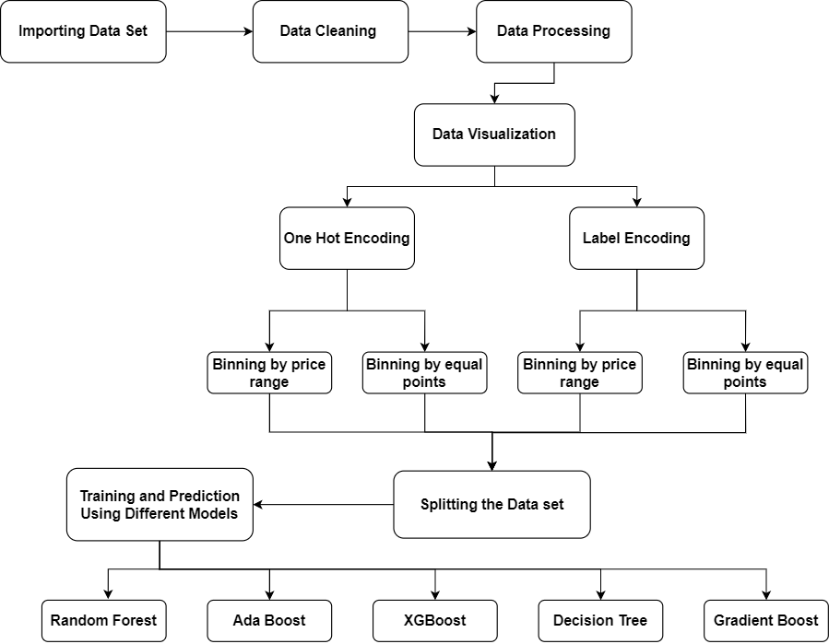
Workflow Diagram :

Slide 4
Data Set
Dataset originally contained the prices and other attributes of almost 54,000 diamonds.
However, 14184 of those seem to be the same diamonds, measure from a different angle.
This can be found out but checking for duplicate value when disregarding the variables x, y, z, depth and table, which are dependent on the angle.
Attributes : "carat","cut","color","clarity","depth","table","price","x","y","z"
Kaggle Repository : https://www.kaggle.com/datasets/ulrikthygepedersen/diamonds

Slide 5
Literature Survey
Several studies have been conducted on predicting diamond prices using machine learning algorithms.
Linear regression, random forest regression, and gradient boosting regressor are commonly used models.
Diamond weight, color, and clarity are the most significant factors affecting diamond prices.
There is a significant level of subjectivity in diamond pricing due to socially formed ideas and price obfuscation techniques used by dealers.
Machine learning techniques are also used in other fields such as fatigue driving detection and web page classification.

Slide 6
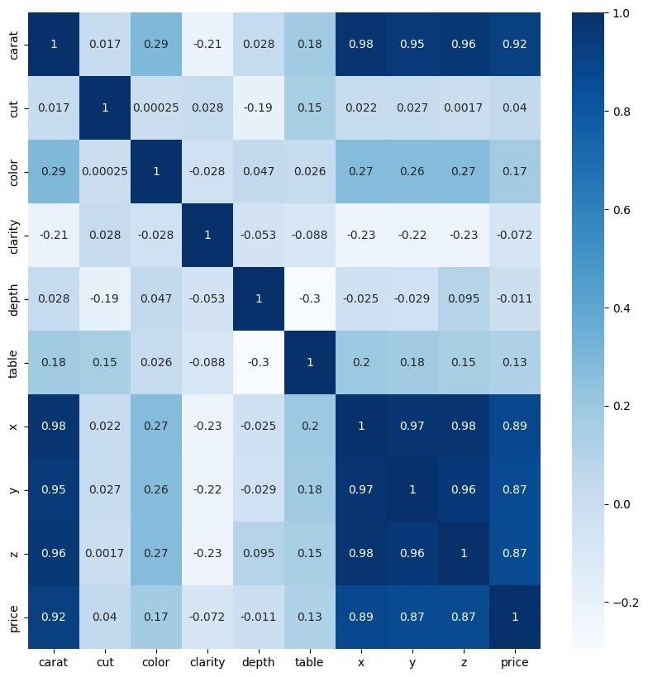
Data Visualization :
Correlation Matrix :

Slide 7
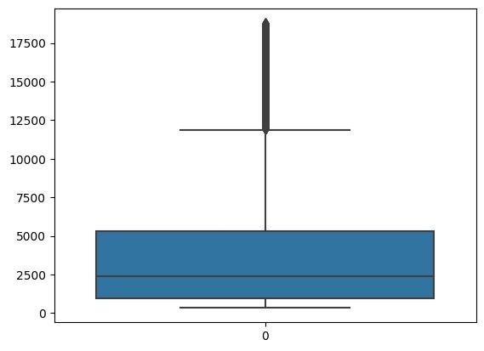
Data Visualization :
Price distribution of diamonds in the dataset :

Slide 8
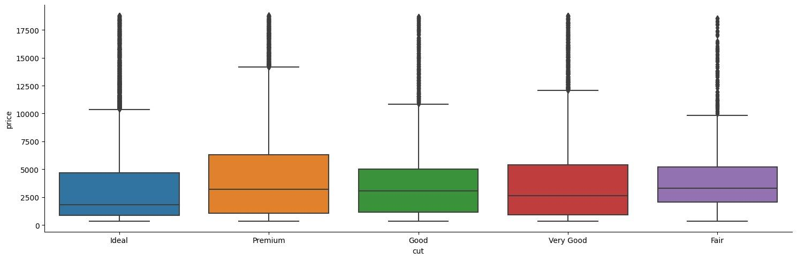
Data Visualization :
Distribution of price by every category of ‘cut’ :

Slide 9
Contents
One hot encoding
Label encoding
Binning
Performance measures used
Algorithms used
Explanations of algorithms and output
References

Slide 10
One Hot Encoding
One hot encoding is a process of converting categorical data into a numerical format that can be used for machine learning algorithms.
Each category is represented as a binary vector with a single "1" and all other values as "0".
This allows algorithms to process categorical data as numerical input.
One hot encoding is commonly used for text classification, recommendation systems, and image recognition.

Slide 11
Label Encoding
Label Encoding is a process of transforming categorical variables into numerical labels.
In this method, each unique category in a variable is assigned an integer value.
The assigned labels are arbitrary and don't hold any ordinal meaning.
Label Encoding is useful when the categorical variable has only two categories, and there is a natural ordering between them.
However, it may not be the best approach when there are more than two categories, and the variable does not have an inherent order.

Slide 12
Binning
Binning, also known as discretization, is a data preprocessing technique that involves dividing a continuous numerical variable into a set of discrete intervals, or "bins".
This can help to reduce the impact of minor fluctuations in data and make it easier to identify trends and patterns.
Binning can be done using different strategies such as equal width, equal frequency or clustering-based.

Slide 13
Performance Measures Used
Accuracy : Accuracy represents the number of correctly classified data instances over the total number of data instances.
Precision : It is the ratio of the number of true positive predictions to the total number of positive predictions made by the model.
Recall : expresses the ability to find all relevant instances of a class in a data set.
F1_Score : The F1 score is the harmonic mean of precision and recall.

Slide 14
Algorithms used
Random Forest
XGBoost
Adaboost
Decision Tree
Gradient Boost

Slide 15
Decision Tree
Decision Trees are a popular supervised learning method for solving classification and regression problems.
They partition the data into smaller subsets based on certain criteria and recursively continue this process until a decision is reached.
Each internal node represents a feature or attribute, and each branch represents a possible value or decision based on that feature.
The goal of a Decision Tree is to create a model that predicts the target variable by making decisions based on the provided input features.
Decision Trees are intuitive, easy to understand, and provide useful insights into the decision-making process. However, they can be prone to overfitting, and their accuracy may not be as good as some other machine learning models.

Slide 16
Random Forest
Random Forest is an ensemble machine learning algorithm that builds multiple decision trees and combines their predictions to improve accuracy and prevent overfitting.
Each decision tree is trained on a random subset of the training data and a random subset of the features, creating a diverse set of trees.
During prediction, each tree in the forest independently predicts the target variable, and the final prediction is made by averaging or taking the majority vote of the individual tree predictions.
Random Forest can be used for both classification and regression tasks and is known for its high accuracy, robustness, and ability to handle high-dimensional data.
Some of the key parameters to tune in Random Forest include the number of trees in the forest, the maximum depth of the trees, and the number of features to consider when looking for the best split at each node.

Slide 17
XGBoost
XGBoost stands for eXtreme Gradient Boosting and is a popular open-source gradient boosting library.
It is designed to be highly scalable and can handle large datasets with high-dimensional features.
XGBoost works by iteratively building decision trees and combining them to create a strong predictive model.
It uses gradient boosting, a technique where each new tree corrects the errors made by the previous tree, to improve its performance.
XGBoost has become a go-to algorithm for many machine learning competitions and is widely used in industry due to its excellent performance and versatility.

Slide 18
Gradient Boost
Gradient Boost is a boosting algorithm that combines multiple weak prediction models to build a strong predictive model.
It involves building models sequentially, with each subsequent model correcting the errors of the previous model.
At each iteration, the model tries to fit the negative gradient of the loss function of the previous model.
The final prediction is made by aggregating the predictions of all the models.
Gradient Boost is widely used in machine learning competitions and is known for its high accuracy and ability to handle complex datasets.

Slide 19
AdaBoost
AdaBoost (Adaptive Boosting) is a boosting algorithm that combines weak learners (usually decision trees) to create a strong learner.
The basic idea behind AdaBoost is to assign weights to each observation in the dataset, and then fit a sequence of models where each subsequent model places more emphasis on the misclassified observations from the previous model.
In other words, AdaBoost creates a sequence of models that iteratively corrects the errors of the previous model, until a final model is created that makes accurate predictions for the entire dataset.
AdaBoost has been widely used in applications such as face detection, text classification, and financial prediction, among others.
One of the strengths of AdaBoost is that it can handle both binary and multi-class classification problems, as well as regression problems. However, it can be sensitive to noisy data and outliers, which may negatively impact its performance.

Slide 20
Output (Accuracy)
Method Used | Label Encoding Binning By Equal Points | Label Encoding Binning By Equal Prices | One Hot Encoding Binning By Equal Data Points | One Hot Encoding Binning By Equal Price
Algorithms
Gaussian NB | 51.05% | 70.92% | 53.54% | 69.96%
Decision Tree | 77.58% | 83.53% | 77.38% | 83.85%
XgBoost | 83.76% | 87.07% | 83.52% | 87.18%
Random Forest | 83.10% | 87.16% | 82.10% | 87.51%
Gradient Boosting | 77.18% | 84.03% | 75.69% | 83.73%
Adaboost | 30.12% | 60.57% | 30.12% | 60.57%

Slide 21
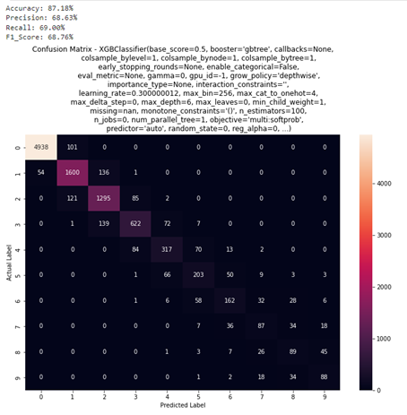
Output
XGBoost : Accuracy 87.18 % with OneHotEncoding and binning by equal data points without HyperParametre tuning

Slide 22
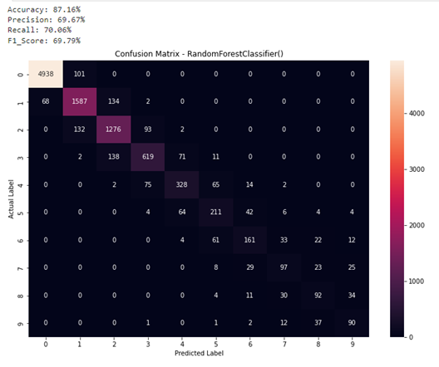
RandomForest : Accuracy 87.16 % with OneHotEncoding by binning by equal data points without HyperParametre tuning

Slide 23
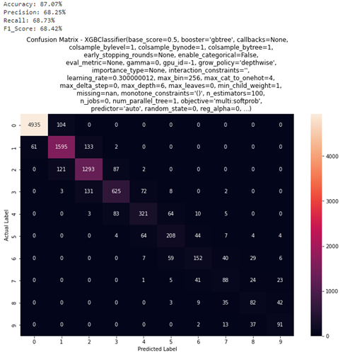
XGBoost: Accuracy 87.07% with LabelEncoding by binning by equal price range without HyperParametre tuning

Slide 24
RandomForest : Accuracy 87.16% with LabelEncoding by binning by equal price range without HyperParameter tuning

Slide 25
Conclusion
Random Forest Classifier is the best performing model on this dataset, with accuracy: 87.51%.
Regression analysis could have achieved higher MSE, but in the real world, a range of price would be more beneficial to the stakeholders rather than an exact price.
Exploratory data analysis of the dataset indicate that most of the diamonds listed are in the price range of 800 to 5000 dollars
Tuning the hyperparameters in some models is not improving the performance as such, this is a major finding.

Slide 26
References
[1] Sharma, G., Tripathi, V., Mahajan, M., & Srivastava, A. K. (2021, January). Comparative analysis of supervised models for diamond price prediction. In 2021 11th International Conference on Cloud Computing, Data Science & Engineering (Confluence) (pp. 1019-1022). IEEE.
[2] Alsuraihi, W., Al-hazmi, E., Bawazeer, K., & AlGhamdi, H. (2020, March). Machine learning algorithms for diamond price prediction. In Proceedings of the 2020 2nd International Conference on Image, Video and Signal Processing (pp. 150-154).
[3] Chaijunla, T., & Taninpong, P. Comparative Study of Predicting Diamond Ring Prices in Online Retail Shop.
[4] Basysyar, F. M., & Dwilestari, G. COMPARISON OF MACHINE LEARNING ALGORITHMS FOR PREDICTING DIAMOND PRICES BASED ON EXPLORATORY DATA ANALYSIS.
[5] Mamonov, S., & Triantoro, T. (2018). Subjectivity of diamond prices in online retail: insights from a data mining study. Journal of theoretical and applied electronic commerce research, 13(2), 15-28.
[6] Yong, Z., Jianyang, L., Hui, L., & Xuehui, G. (2018, June). Fatigue driving detection with modified ada-boost and fuzzy algorithm. In 2018 Chinese Control And Decision Conference (CCDC) (pp. 5971-5974). IEEE.
[7] Dutta, J., Kim, Y. W., & Dominic, D. (2020, November). Comparison of gradient boosting and extreme boosting ensemble methods for webpage classification. In 2020 Fifth International Conference on Research in Computational Intelligence and Communication Networks (ICRCICN) (pp. 77-82). IEEE.
[8] Chen, H., Ai, H., Yang, Z., Yang, W., Ye, Z., & Dong, D. (2020, September). An Improved XGBoost Model Based on Spark for Credit Card Fraud Prediction. In 2020 IEEE 5th International Symposium on Smart and Wireless Systems within the Conferences on Intelligent Data Acquisition and Advanced Computing Systems (IDAACS-SWS) (pp. 1-6). IEEE.
[9] Bulbul, H. I., & Unsal, Ö. (2011, December). Comparison of classification techniques used in machine learning as applied on vocational guidance data. In 2011 10th International Conference on Machine Learning and Applications and Workshops (Vol. 2, pp. 298-301). IEEE.
[10] Yue, Y., & Yang, Y. (2020, February). Improved Ada Boost Classifier for Sports Scene Detection in Videos: from Data Extraction to Image Understanding. In 2020 International Conference on Inventive Computation Technologies (ICICT) (pp. 1-4). IEEE.

